Slide 1



Concerns about AI and Big Data Projects
Tools
Wow, there’s a lot of tools out there. Which one do I need? Do I need more than one?

Slide 2

Concerns about AI and Big Data Projects
Skills
Tools
Do I currently have these skills in my organization?

Slide 3

Concerns about AI and Big Data Projects
Skills
Cost
Tools
How much will this new solution, all its infrastructure, and the hires and training cost?

Slide 4

Concerns about AI and Big Data Projects
Skills
Cost
Tools
Time
How long will it take me to get to production and realize any value from the solution?

Slide 5
Recent CIO/IDG Research Services Survey
What’s happening in AI Projects?
90% Investing Heavily in AI
1 in 3 Projects Make it to Production
Projects average more than 6 months to make it to production

Slide 6
Recent CIO/IDG Research Services Survey
What is contributing to AI project hardships?
Data-related challenges are slowing 96% of organizations
56% claim data prep and aggregation of Big Data is Very/Extremely Challenging.
56% claim data exploration and iterative model development with Big Data is Very/Extremely Challenging.
53% claim deploying models to production quickly and reliably is Very/Extremely Challenging.
80% experience reduced productivity due to siloed data science and engineering
Average of 7 different tools

Slide 7

What is Azure Databricks?
Unified data platform in Azure providing fast, secure, collaborative analytics using Apache Spark.

Slide 8








What Use-Cases is Azure Databricks Good For?
Interactive Analytics
Batch ETL Processing
Machine Learning
Streaming Event Processing

Slide 9






Who Uses Azure Databricks
Data Engineer
Data Scientist
Business Analyst
Transform data and create and schedule batch and streaming ETL jobs
Explore data, create and deploy machine learning models, and perform other advanced analytics tasks
Write SQL queries and analyze and visualize data in Databricks notebooks or tools like Power BI and Tableau

Slide 10

Works with Popular Programming and Query Languages
SQL
Write ETL, train machine learning models, and write ad-hoc queries for data analysis using popular and familiar languages.
Python
R
Scala

Slide 11









Works with Popular Data Science and Deep Learning Frameworks
=
Machine Learning
Azure ML
Amazon ML

Slide 12
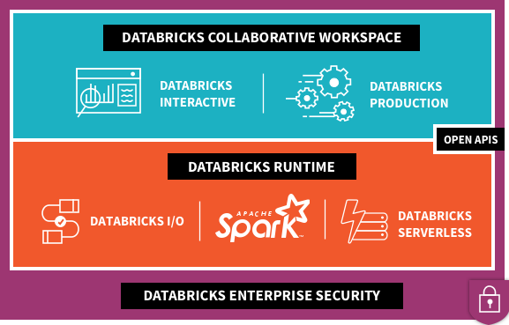


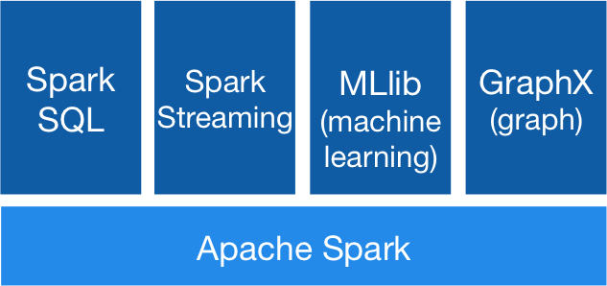









What’s Under the Hood?
2
1
Data Factory
Power BI
3
Data Lake
Store
Blob
Storage
SQL Data
Warehouse
SQL DB
Cosmos DB
Event Hubs
Kafka
On HDInsight

Slide 13
What’s Under the Hood?
Data Factory
Power BI
Data Lake
Store
Blob
Storage
SQL Data
Warehouse
SQL DB
Cosmos DB
Event Hubs
Kafka
On HDInsight

Slide 14
What’s Under the Hood?
2
1
Data Factory
Power BI
3
Data Lake
Store
Blob
Storage
SQL Data
Warehouse
SQL DB
Cosmos DB
Event Hubs
Kafka
On HDInsight

Slide 15
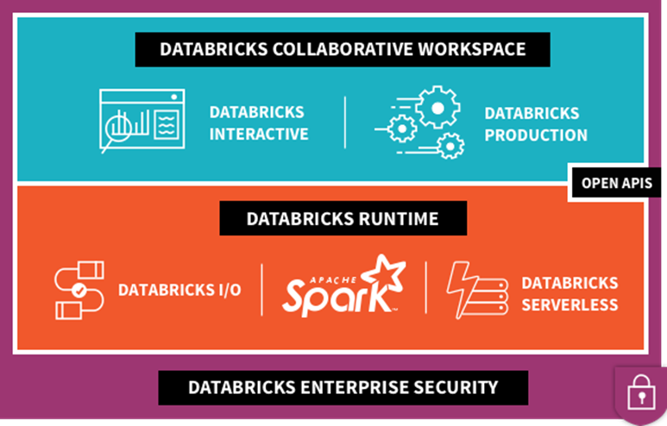
What’s Under the Hood?
2
Data Factory
3
1
Power BI
4
Data Lake
Store
Blob
Storage
SQL Data
Warehouse
SQL DB
Cosmos DB
Event Hubs
Kafka
On HDInsight

Slide 16
What’s Under the Hood?
2
1
Data Factory
Power BI
3
Data Lake
Store
Blob
Storage
SQL Data
Warehouse
SQL DB
Cosmos DB
Event Hubs
Kafka
On HDInsight

Slide 17
What’s Under the Hood?
Supported Azure Storage
Connectivity to Other Services
2
Kafka
On HDInsight
Data Factory
Data Lake
Store
Blob
Storage
SQL Data
Warehouse
SQL DB
Cosmos DB
Event Hubs
Power BI
Power BI
Data Factory
Data Lake
Store
Blob
Storage
SQL Data
Warehouse
SQL DB
Cosmos DB
Event Hubs
Kafka
On HDInsight

Slide 18







Where Does Azure Databricks Fit in the Azure Data and AI Platform?
Data Factory
Data Lake Store
Cognitive
Services
Machine Learning
Services
Power BI
Event Hubs
Blob Storage
Data Lake
Analytics
Stream
Analytics
HDInsight
Logic Apps
SQL Data Warehouse
Apps
HDInsight w/Kafka
Cosmos DB
Ingest
Store
Train and Prepare
Serve and Publish

Slide 19





Modern Data Platform with Azure Databricks
Ingest
Store
Prep and train
Serve
Model Serving
Azure Machine Learning service
Azure Kubernetes service
Azure Event Hubs
Streaming data
Operational Databases
Apps
Cosmos DB, SQL DB
Azure Databricks
Ad-hoc Analysis
Power BI
Batch data
Azure analysis services
Azure Data Factory
Azure Data Lake Storage
Azure SQL data warehouse

Slide 20
Modern Big Data Warehouse
Ingest
Store
Prep & Train
Model & Serve
Intelligence
Logs, files and media (unstructured)
Data factory
Azure storage
Azure Databricks
(Spark)
Business / custom apps
(Structured)
Polybase
Data factory
Azure SQL Data Warehouse
Analytical dashboards

Slide 21
Advanced Analytics on Big Data
Ingest
Store
Prep & Train
Model & Serve
Intelligence
Logs, files and media (unstructured)
Data factory
Azure storage
Azure Databricks
(Spark Mllib, SparkR, SparklyR)
Azure Cosmos DB
Web & mobile apps
Business / custom apps
(Structured)
Polybase
Data factory
Azure SQL Data Warehouse
Analytical dashboards

Slide 22
Real-time analytics on Big Data
Ingest
Store
Prep & Train
Model & Serve
Intelligence
Unstructured data
Azure HDInsight (Kafka)
Azure Databricks
(Spark)
Polybase
Azure storage
Azure SQL Data Warehouse
Analytical dashboards

